Slide 1
Leadership and Management Behavior in Multinational Companies
Multinational Management
耿延

Slide 2
Learning Objectives (1 of 3)
Know the characteristics of global business leadership.
Describe traditional North American models of leadership, including trait theory, behavioral approaches, and contingency theory.
Explain the Japanese performance-maintenance model.
Apply the cultural-contingency model of leadership

Slide 3
Learning Objectives (2 of 3)
Develop sensitivity to national cultural differences in preferred leadership traits and effective leadership behaviors.
Discuss how national culture affects the choice of leader influence tactics.
Discuss how national culture influences subordinates’ expectations regarding appropriate behaviors and the traits of leaders.

Slide 4
Learning Objectives (3 of 3)
Explain the role of transformational leadership in multinational settings.
Understand how national culture affects a leader’s attributions regarding subordinates’ behaviors.
Diagnose cultural situations and suggest appropriate leadership styles to fit them.

Slide 5
Leadership
The GLOBE’s universal definition of Leadership:
  “the ability of an individual to influence, motivate, and enable others to contribute toward the effectiveness and success of the organizations of which they are members.”
Effective multinational leadership is more challenging than being a good domestic leader.
Widely different leadership styles may be equally effective in reaching goals in various cultures.

Slide 6
Global Leadership:
The New Breed
The Global Leader must have the skills and abilities to interact with and manage people from diverse cultural backgrounds in their multinational organization.
Characteristics of a global leader:
  Cosmopolitan
  Skilled at intercultural communication
  Culturally sensitive
  Capable of rapid acculturation

Slide 7
Global Leadership: Characteristics
Characteristics of a global leader: (cont’d)
  A facilitator of subordinates’ intercultural performance
  A user of cultural synergy
  A promoter and user of the growing world culture
  Emotionally intelligent

Slide 8
Three Classic Models:
A Vocabulary of Leadership
The three basic models of leadership entail:
  Leadership traits
  Leadership behavior
  Contingency leadership

Slide 9
Leadership Traits (1 of 2)
Are leaders born or made?
The Great-Person Theory is the idea that leaders are born with unique characteristics that make them quite different from ordinary people.
Contemporary views of leadership traits do not assume that leaders are born.
Although leaders are different, aspiring leaders can achieve this difference by training and experience.

Slide 10
Leadership Traits (2 of 2)
In the U.S., successful leaders exhibit:
  High intelligence & self-confidence
  Great initiative
  Assertiveness & persistence
  A great desire for responsibility and the opportunity to influence others
  A high awareness of the needs of others

Slide 11
U.S. Perspectives:
Leadership Behaviors (1 of 2)
Although leaders have different traits than subordinates, traits alone do not make a leader.
The behaviors leaders use to manage employees may be more important.
Classic U.S. studies of leadership reveal two types:
  A task-centered leader gives specific directions to subordinates so that they can complete tasks.
  A person-centered leader focuses on meeting the social and emotional needs of employees.

Slide 12
U.S. Perspectives:
Leadership Behaviors (2 of 2)
The distinction between task-centered and person-centered also applies to how leaders make decisions:
  Leaders who adopt an autocratic leadership style make all major decisions themselves.
  Those who employ a democratic leadership style delegate the decision-making to subordinates.
  The consultative and participative leadership styles falls midway between the autocratic and democratic styles.

Slide 13
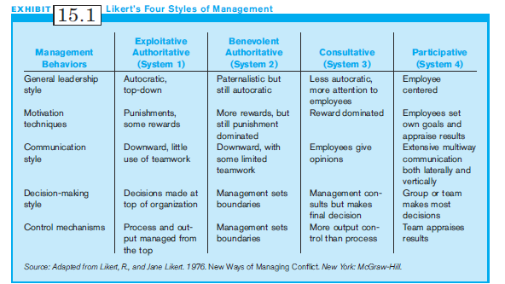
Exhibit 15.1:
Likert’s Four Styles of Management

Slide 14
Japanese Perspectives:
Performance Maintenance Theory (1 of 2)
The Performance-Maintenance (PM) Theory of leadership represents a Japanese perspective, balancing task- and person-centered leader behaviors
Has two dimensions
  Performance (similar to task-centered)
  Maintenance (similar to person-centered)

Slide 15
Japanese Perspectives:
Performance Maintenance Theory (1 of 2)
There are two components of performance function:
    Planning component: the leader works for or with subordinates to develop work procedures
    Pressure component: the leader then pressures employees to put forth more effort and to do good work

Slide 16
Contingency Theories
The Contingency Theories assume that the appropriate style and leader depends on the situation.
Successful leaders choose leadership style based on situations.
There are two North American contingency theories of leadership:
  Fiedler’s theory of leadership
  Path-goal theory

Slide 17
Fiedler’s Theory of Leadership (1 of 2)
Fiedler’s Theory of Leadership holds that managers tend to be either task- or person-centered leaders.
Success depends on three contingencies or characteristics of work situation:
  The relationship between leader and subordinates
  The degree to which subordinates’ tasks are clearly defined
  The officially granted power of the leader

Slide 18
Fiedler’s Theory of Leadership (2 of 2)
Effective leadership occurs when the leadership style matchs the situation.
Fiedler’s Theory suggests that task-centered leadership works best in situations that are either favorable or unfavorable for a leader.
Person-centered leadership works best in situations that are not clearly favorable or unfaborable.

Slide 19
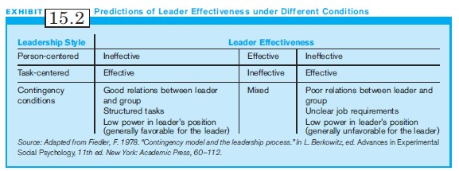
Exhibit 15.2:
Predictions of Leader Effectiveness under Different Conditions

Slide 20
Path-Goal Theory
Using Path-Goal Theory, a leader might adopt one of four leadership styles, depending on the situation. These four styles are:
  Directive (give subordinates specific goals)
  Supportive (show concern for their needs)
  Participative (consult with them and encourage)
  Achievement-oriented (set goals and reward goal accomplishments)

Slide 21
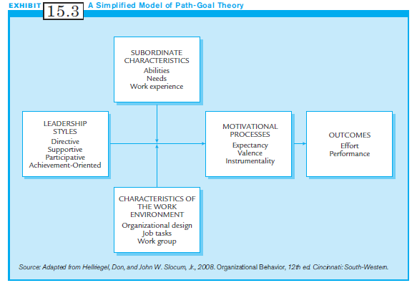
Exhibit 15.3:
A Simplified Model of Path-Goal Theory

Slide 22
Path-Goal Theory:
Key Suggestions
When subordinates have high achievement needs, adopt the achievement-oriented style.
For subordinates with high social needs, adopt the supportive leadership style.
When the job is unstructured, adopt a directive style or an achievement-oriented style.

Slide 23
Traits, Behaviors & Contingencies
Leaders have a variety of behaviors they can use to get the job done.
Most experts now believe that no one leadership trait or behavior works best in all situations.
A successful leader must diagnose the situation, pick the behaviors and develop the leadership traits that fit best.

Slide 24
National Context Contingency Model of Leadership (1 of 2)
Successful leadership in multinational companies requires that managers adjust their leadership styles to fit different situations.
  Learn what local managers do to lead successfully in their own countries.
  Use that knowledge to modify your leadership style appropriately.

Slide 25
National Context Contingency Model of Leadership (2 of 2)
In a multinational setting, these components are all affected by the national context:
  Leader behaviors & traits
  Subordinates characteristics
  Work setting

Slide 26
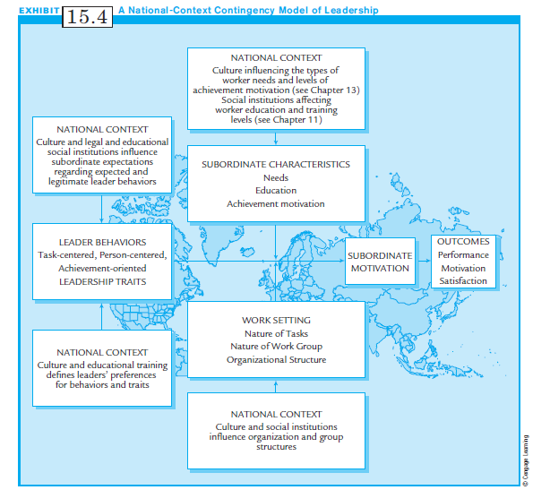
Exhibit 15.4:
National-Context Contingency Model of Leadership

Slide 27
Leadership Traits and Behaviors in the National Context
People prefer certain traits and behaviors in their leaders depending on their cultural backgrounds, though some behaviors & traits are cultural universals.
GLOBE (Global Leadership and Organizational Behavior Effectiveness) conducted cross-national research of 60 nations on differences in leadership.
Their study contains insights that can help a manager develop leadership styles to navigate successfully through a maze of cultural settings.

Slide 28
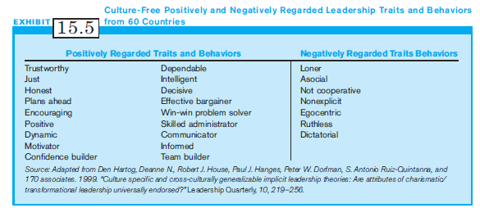
Exhibit 15.5
Culture-Free Positively and Negatively Regarded Leadership Traits & Behaviors

Slide 29
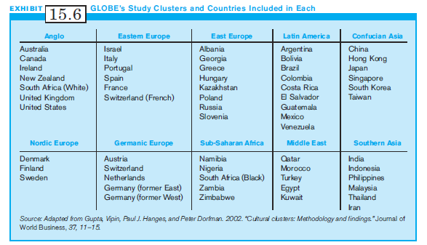
Exhibit 15.6:
GLOBE’s Study Clusters and
Countries Included in Each Cluster

Slide 30
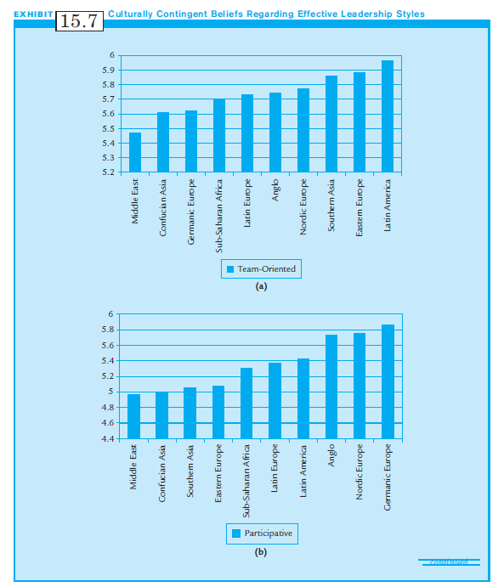
Exhibit 15.7:
Culturally Contingent Beliefs Regarding Effective Leadership Styles

Slide 31
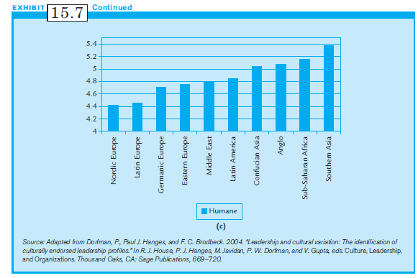
Exhibit 15.7: (cont’d)
Culturally Contingent Beliefs Regarding Effective Leadership Styles

Slide 32
GLOBE Findings
Leadership styles vary by country.
Team-oriented leaders preferred in Latin European, East European and Southern Asian societies.
Participative leaders are preferred by Anglo, Nordic European, and Germanic European cultures.
Humane leaders preferred in Southern Asian cultures.
All agreed that autonomous leaders and self-protective leaders universally impeded leadership.

Slide 33
National Context and Preferred Leader Influence Tactics
Influence Tactics are tactical behaviors leaders use to influence subordinates.
U.S managers favor seven influence tactics
    Assertiveness
    Friendliness
    Reasoning
    Bargaining
    Sanctioning
    Appeals to a higher authority
    Coalitions

Slide 34
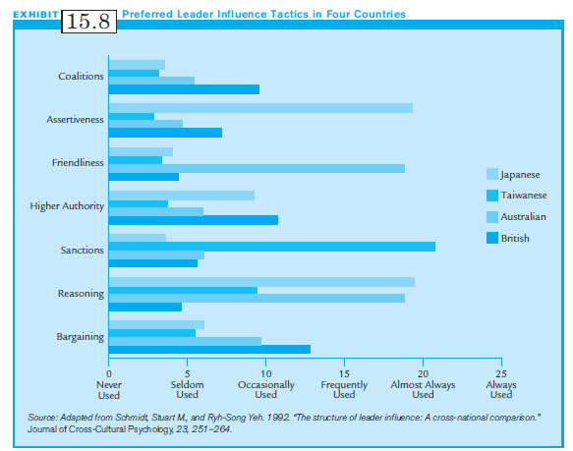
Exhibit 15.8:
Preferred Leader Influence Tactics in Four Countries

Slide 35
National Context and Subordinates’ Expectations (1 of 2)
The national context affects Subordinates’ Expectations: what leaders “should” do and what they may or may not do.
Power distance has profound effects on expectations:
  In high power-distance countries, autocratic leadership is expected.
  In low power-distance countries, the leader should forego status symbols, & involve subordinates in decision-making.

Slide 36
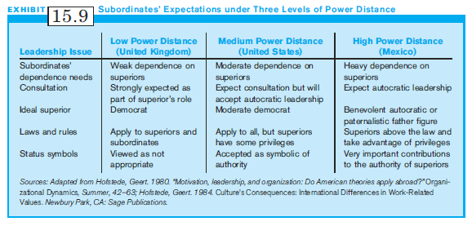
Exhibit 15.9:
Subordinates’ Expectations under Three Levels of Power Distance

Slide 37
National Context and Subordinates’ Expectations (2 of 2)
Other cultural values affect subordinates’ expectations:
  Strong masculinity norms lead to the acceptance of more authoritarian leadership
  Strong uncertainty-avoidance norms lead subordinates to expect the leader to provide more detail in directions

Slide 38
Contemporary Leadership Perspectives:
Multinational Implications
There are two contemporary approaches to leadership:
  Transformational Leadership
  Attribution Approach
The GLOBE study found that Transformational Leadership was considered superior in almost all societies.

Slide 39
Transformational Leaders (1 of 2)
The Transformational Leader:
  Articulates a vision
  Breaks from the status quo
  Provides goals and a plan
  Gives meaning or a purpose to goals
  Takes risks
  Is motivated to lead
  Builds a power base
  Demonstrates high ethical and moral standards

Slide 40
Transformational Leaders (2 of 2)
Transformational leaders succeed because subordinates respond to them with high levels of performance, personal devotion, reverence, excitement about leader’s ideas, and willingness to sacrifice for the good of the company
Transformational Leaders go beyond Transactional Leadership which uses punishment and rewards.
The same leadership traits may not lead to transformational leadership in all countries.

Slide 41
Attributions and Leadership (1 of 2)
The attributional approach to leadership emphasizes the leader’s attributions regarding the causes of subordinates’ behaviors.
In determining how to respond to a subordinate’s behavior, the leader makes two key distinctions:
  External attribution: factors outside the person and beyond the person’s control (illness); or
  Internal attribution: characteristics of the person (e.g., personality, motivation, low ability, etc.)

Slide 42
Attributions and Leadership (2 of 2)
Once leader makes an attribution, the leader responds to the subordinate based on that assumption.
  Internal attribution : behavior corrected or rewarded
  External attribution: modify the work environment
Fundamental attribution error: an assumption by a manager that people behave in certain ways because of internal motivations, rather than outside factors
Successful leaders make the correct attributions.

Slide 43
Getting the Results: Should You Do What Works at Home?
The contingency view of leadership suggests that managers cannot assume that successful home leadership styles or traits will result in equally successful leadership in a foreign country.
Managers need to modify and adapt leadership styles to be congruent with the cultural setting.
Without adequate cross-cultural training, expatriates may continue to apply their previously successful home style leadership in international settings.

Slide 44
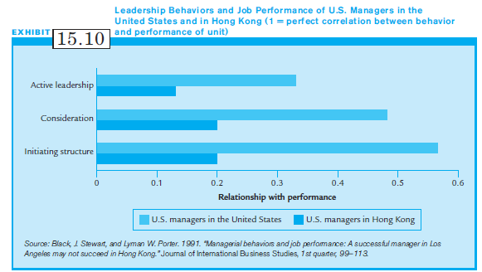
Exhibit 15.10: Leadership Behavior and Job Performance of U.S. Managers in U.S. & Hong Kong

Slide 45
The Cultural Context and Suggested Leadership Styles
Because of the extreme variability among cultures and nations, there are few prescriptive theories of multicultural leadership.
But there may be some general recommendations based on research re power distance & uncertainty:
  In high power distance cultures, behave more autocratically.
  In high uncertainty cultures, remove ambiguity from the work setting.

Slide 46
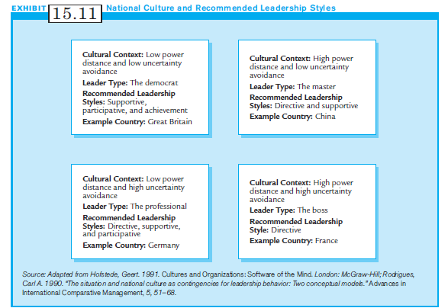
Exhibit 15.11:
National Culture and Recommended Leadership Styles

Slide 47
Summary
All multinational managers should strive to become global leaders.
Important information on the nature of leadership and understanding of leadership in the international setting are reviewed.
We also review some classic leadership theories and applies them to the international settings.
Effective leadership is essential for the success of the multinational company.

